Slide 1
(U) STS Presentation
UNCLASSIFIED or CUI or CONFIDENTIAL or SECRET
(U) Subtitle
CONTROLLED UNCLASSIFIED INFORMATION:
Controlled by: Conventional Prompt Strike, Program Office
Categories: CTI, Defense, Export Control, Financial, Procurement and Acquisition, Provisional, Privacy Distribution/Dissemination Control: Distribution C
EXPORT CONTROLLED INFORMATION:
WARNING: This document contains technical data whose export is restricted by the Arms Export Control Act (Title 22, U.S.C. 2751, et seq.) or the Export Administration Act of 1979, as amended, Title 50, U.S.C., App. 2401, et seq. Violation of these export-control laws is subject to severe criminal penalties. Dissemination of this document is controlled under DODD 5230.25 and AFI 61-204.
DISTRIBUTION STATEMENT C [D]: Distribution authorized to U.S. Government Agencies and their contractors [Department of Defense and U.S. DoD contractors only] (fill in reason) (date of determination). Other requests for this document shall be referred to (controlling DoD office).
Author(s): Jane Smith, John Brown
Organization: Your Organization
Email: jane_smith@yourorg.com
Phone: 202-555-5555
Classified by: Name of document originator and job title
Derived from:
Declassify on:
UNCLASSIFIED or CUI or CONFIDENTIAL or SECRET
This slide is Unclassified
Notes:
CUI box must also appear on documents marked SECRET or higher.
UNCLASSIFIED
UNCLASSIFIED

Slide 2
(U) Title = 30pt Bold for Main Title
UNCLASSIFIED
(U) First-level text = 26pt
(U) Second-level text = 24pt
(U) Label each slide with the highest classification of the content of the slide.**
(U) Portion mark all images and text.
(U) Please keep text to a minimum for each slide. The STS Speakers Kit provides guidelines.
(U) The following slides provide options for including videos.
CLASSIFICATION = 11PT BOLD ALL CAPS
*(U) Footnote = 14-pt minimum
**(U) Classifications on this slide are for illustration only.
UNCLASSIFIED
Notes:
UNCLASSIFIED
UNCLASSIFIED

Slide 3
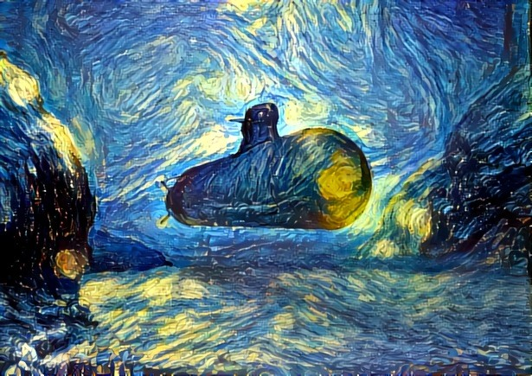
(U) Slide Annotations
UNCLASSIFIED
(U) Use the notes section of your PowerPoint slides to include descriptions and content you would normally be included in the verbal part of your presentation.
(U) See the notes section of this slide for an example of annotation.
(U) Annotations must include paragraph markings for classified briefs.
CLASSIFICATION = 11PT BOLD ALL CAPS
UNCLASSIFIED
Notes:
(U) Slide annotations are an important addition to PowerPoint files. Because presentations will not include verbal narrative when published in the STS Proceedings, annotations are needed to explain key concepts, data, results, and graphics to the audience who might be unable to attend the Symposium and who will only be viewing the material from the Proceedings DVD. For each slide, limit the text of the annotations to ~170 words (14-pt) or 230 words (12-pt). If more text is required, repeat the slide and continue the additional text in the notes area. The next paragraph is an annotation for the picture included on this slide.
(U) The picture on the right side is an image that was generated by the Google Deep Dream Generator. It was initially an artist drawing of a submarine underwater. Using the “Starry Night” theme, and the power of Deep Learning technology, the Deep Dream generator is able to make the image look like it was painted by Vincent Van Gogh in the theme of this Starry Night painting. You can go to this website, https://deepdreamgenerator.com/ and upload your own pictures to make them look like this or many other themes.
UNCLASSIFIED
UNCLASSIFIED

Slide 4
(U) Adding Videos to PowerPoint
UNCLASSIFIED
(U) Subtitle 18pt
Instructions on how to add videos to PowerPoint for “Auto Play” or “Play on Click” are included in the following slides.
Alternatively, APL’s A/V team can set up the videos for you.
For help with video setup and processing (e.g., compressing), please contact Jon.Emmerich@jhuapl.edu
Provide instructions on how you want the movies set up when submitting the second draft of the presentation.
During the presentation, the A/V team can also play videos from the booth when you say “Please play the video.”
UNCLASSIFIED
Notes:
UNCLASSIFIED
UNCLASSIFIED

Slide 5
(U) How to add Videos to PowerPoint
UNCLASSIFIED
To add a video to a PowerPoint slide:
Do not embed (“Insert”) the video file in PowerPoint.
When adding a video to a slide, choose “Link to File.”
When submitting the first draft and final drafts of the presentation, send both PowerPoint and video files.
Video Format
WMV, AVI, or MP4 files are required.
Please keep videos under 5 minutes.
This will keep the PowerPoint file at a manageable size.
UNCLASSIFIED
Notes:
UNCLASSIFIED
UNCLASSIFIED

Slide 6
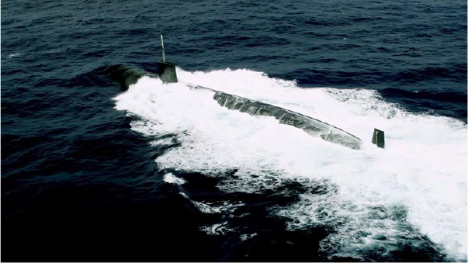
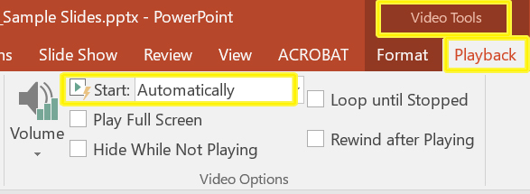
(U) Video Instructions: Auto Play
UNCLASSIFIED
Auto play
Add video by choosing “Link to File.”
With video selected, choose Video Tools, Playback, Start Automatically.
CLASSIFICATION = 11PT BOLD ALL CAPS
Video Auto Play
UNCLASSIFIED
Notes:
UNCLASSIFIED
UNCLASSIFIED

Slide 7
(U) Video Instructions: Play on Click (First of Two Slides)
UNCLASSIFIED
Play on Click
Insert video by choosing “Link to File.”
Duplicate Slide.
Right mouse click on video, copy. Go to first slide, right click, paste as a picture.
Align picture with video.
Send picture to the back, deselect.
Select video, delete.
Go to the second video slide and setup auto playback described earlier.
CLASSIFICATION = 11PT BOLD ALL CAPS
Still Picture
UNCLASSIFIED
Notes:
UNCLASSIFIED
UNCLASSIFIED

Slide 8
(U) Video Instructions: Play on Click (Contd.)
UNCLASSIFIED
Play on Click
Insert video by choosing “Link to File.”
Duplicate Slide.
Right mouse click on video, copy. Go to first slide, right click, paste as a picture.
Align picture with video.
Send picture to the back, deselect.
Select video, delete.
Go to the second video slide and setup auto playback described earlier.
CLASSIFICATION = 11PT BOLD ALL CAPS
Note: Speaker will need to say “Please play video.” A/V staff in the booth will click on the image to launch the video.
UNCLASSIFIED
Notes:
UNCLASSIFIED
UNCLASSIFIED

Slide 9
SECRET
(U) This slide contains examples of SECRET markings.*
(U) There is also a SECRET Slide Master layout that can be applied.
SECRET
*(U) Classifications on this slide are for illustration only.
SECRET
This slide is UNCLASSIFIED
Notes:
UNCLASSIFIED
UNCLASSIFIED

Slide 10
SECRET//NOFORN
(U) This slide contains examples of SECRET//NOFORN markings.*
(U) There is also a SECRET//NOFORN Slide Master layout that can be applied.
SECRET/NOFORN
*(U) Classifications on this slide are for illustration only.
SECRET//NOFORN
This slide is UNCLASSIFIED
Notes:
UNCLASSIFIED
UNCLASSIFIED

Slide 11
UNCLASSIFIED or CUI or CONFIDENTIAL or SECRET
UNCLASSIFIED or CUI or CONFIDENTIAL or SECRET
This slide is Unclassified
Notes:
Final slide should display the overall classification of the presentation.
UNCLASSIFIED
UNCLASSIFIED

