Slide 1
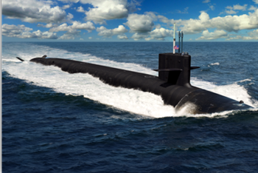
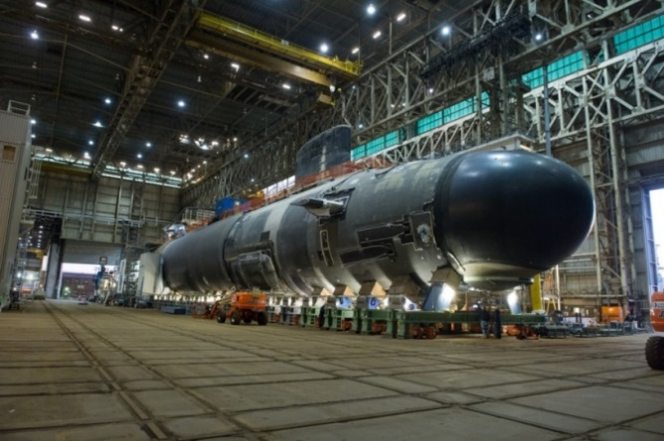
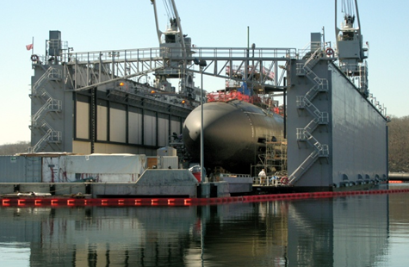
March 5, 2020
Remarks by:
Blair Decker
Bryan Caccavale
Tom Plante
2020 Navy Submarine League
Engineering & Design
Construction
Overhaul and Repair
GENERAL DYNAMICS
Electric Boat
© Copyright Electric Boat Corporation - Use Only With Permission
Electric Boat Proprietary Information
0601/TBD/2020013 Page 1
Notes:
Welcome & thank you for coming
Acknowledge groups that are present
Members of the federal delegation from CT:
Representative Joe Courtney
Senator Richard Blumenthal (is maybe)
Members of state and local government
State Agencies and Town Leaders
Representatives from Chamber of Commerce
Business Leaders
Members of the Press
Representatives from our customer community
Our theme today is “Come Grow with Us.”
On the cover are pictures from an historic day at EB where we christened the South Dakota (SSN790) and opened up the Shipyard in a family day event –--- in essence it was a look under the tent for our families to see what our employees do day-in and day-out
I hope to give you a sense of how we are doing, the contributions we are making to the community, and what we are doing to ensure we are ready to support our customer’s need for more submarines

Slide 2
What Has Been Done So Far to Expand the Base of Submarine Suppliers
Submarine supply base expansion includes:
New suppliers
Expansion of existing suppliers capacity / capability
Product family additions to existing suppliers
Risk mitigation investments for critical processes
Methods utilized include:
Supplier development funding
Dual sourcing
Strategic sourcing
IBAS
CAPEX
Long term tiered volume purchasing agreements

Slide 3
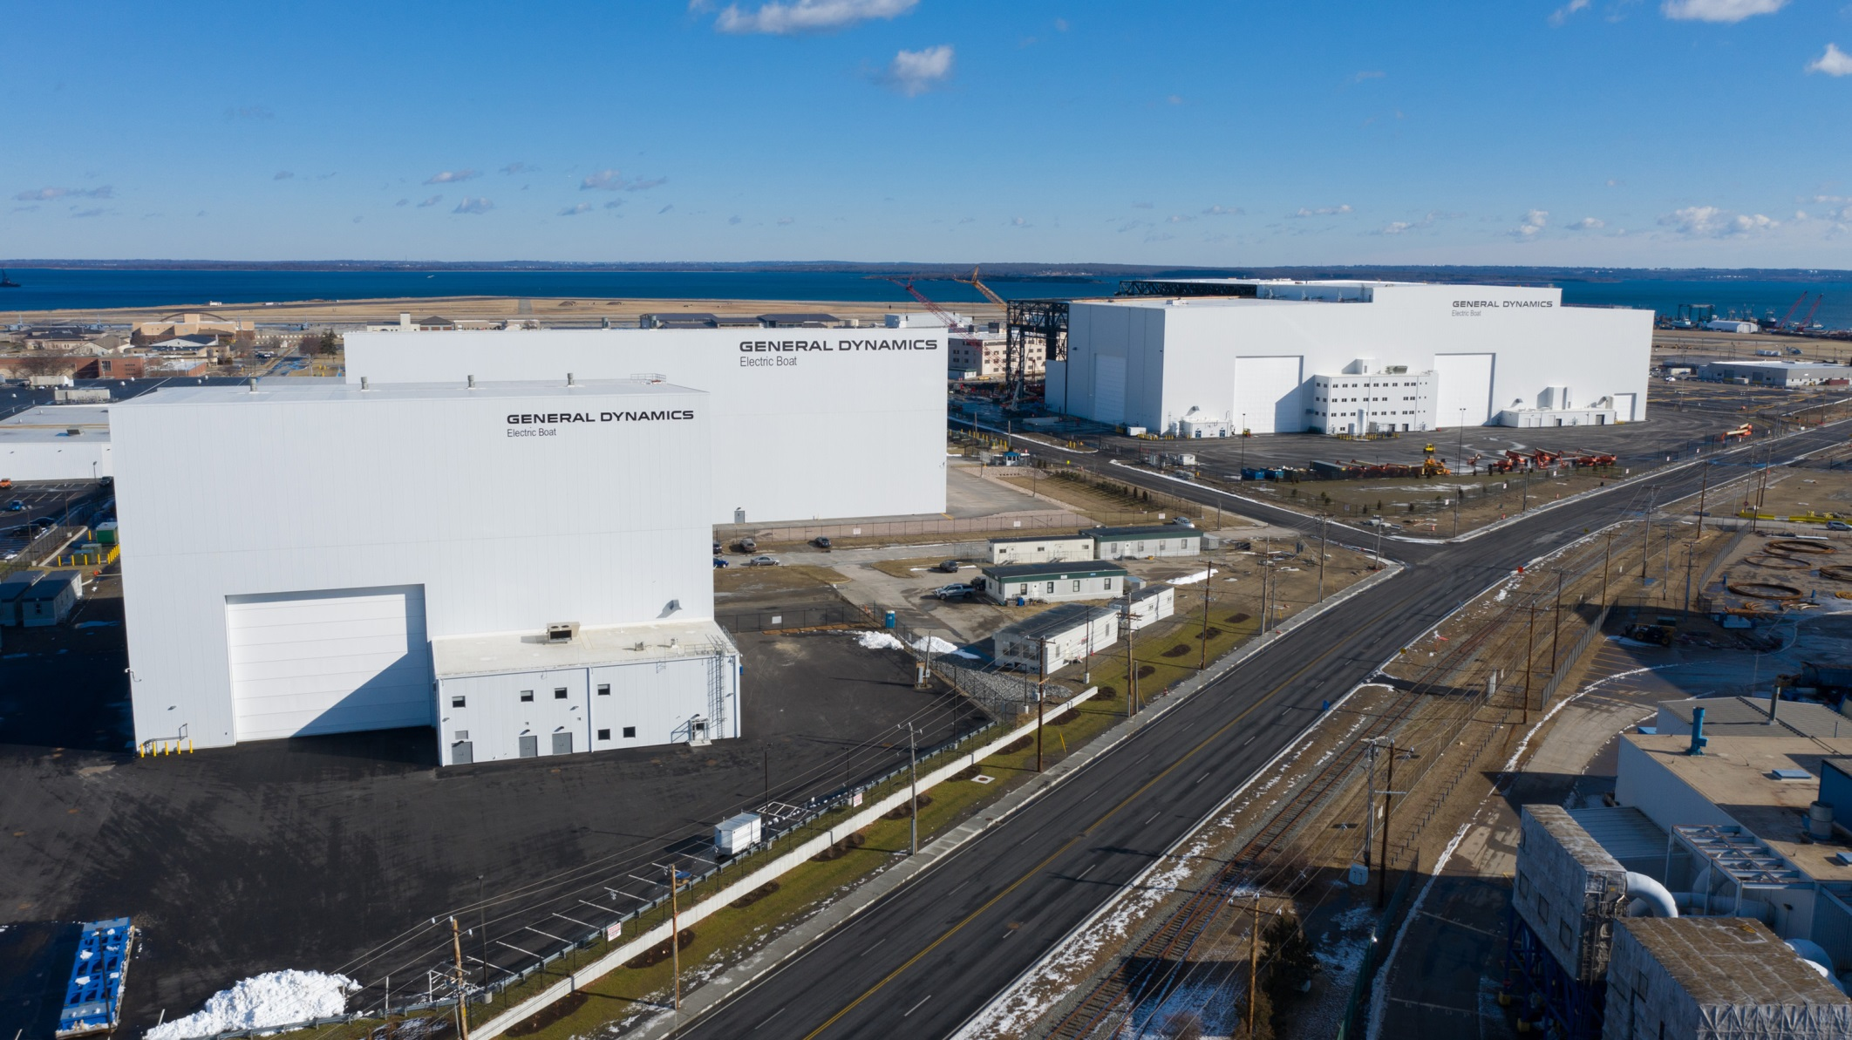
Quonset Point Module Construction Facilities Over 500K Sq. Ft. of Footprint Being Added to Support Core Processes
Columbia AFC
(in Service)
Module Construction 9A
(in Service)
VPM Annex
(in Service)
Roger Williams Way

Slide 4
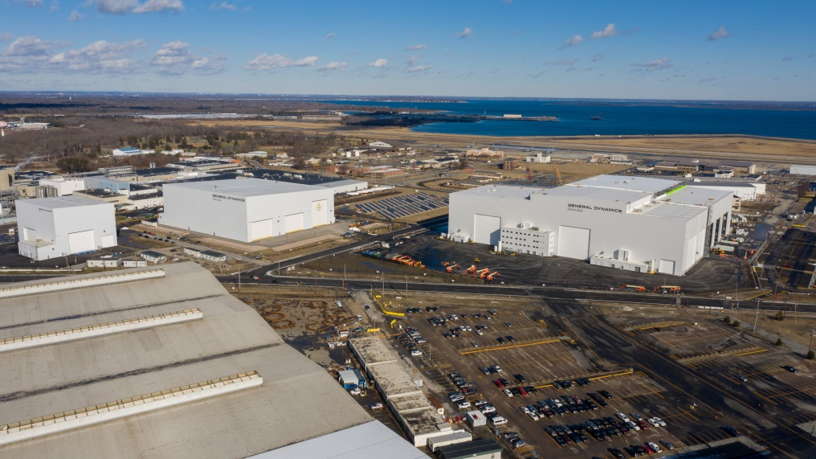
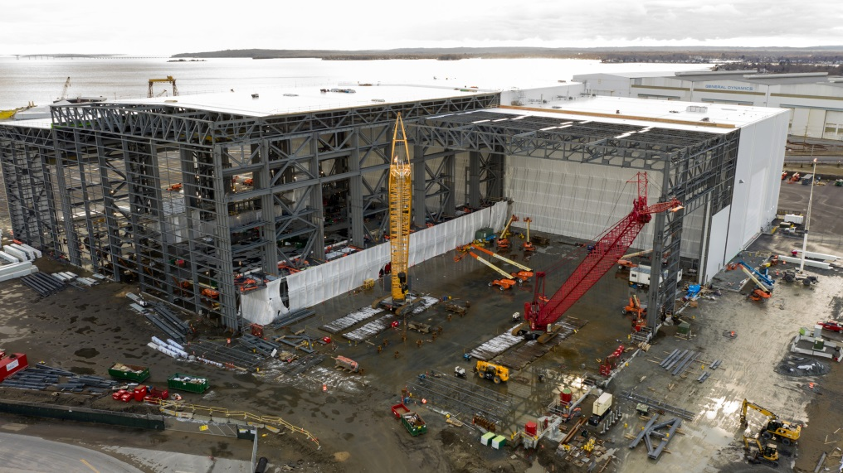
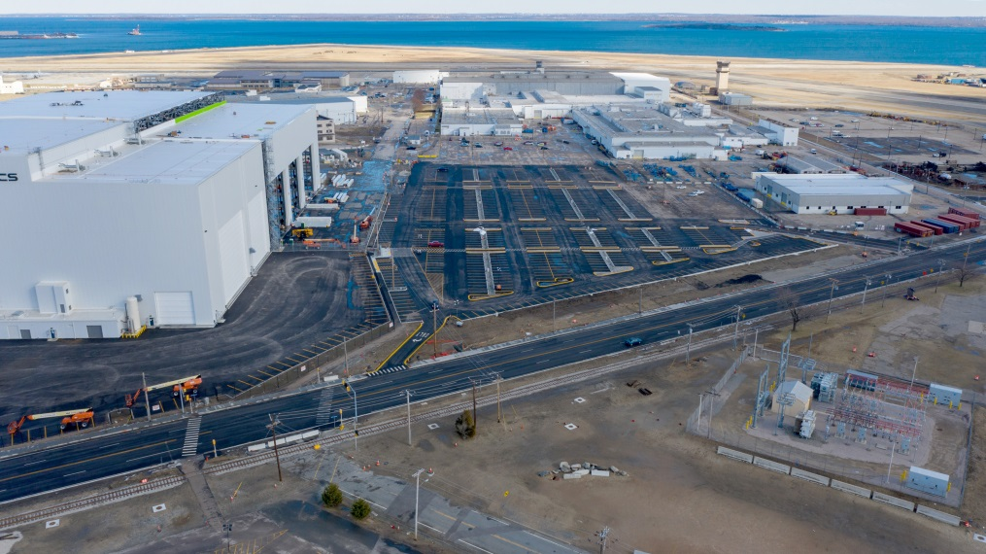
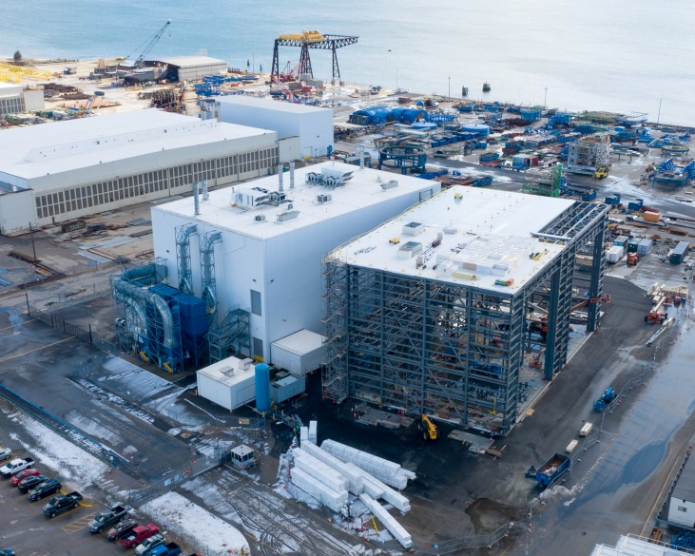
Quonset Point Module Construction Facilities

Slide 5
What Kind of Additional Suppliers of Products/Material Are Needed
Quonset Point Manufacturing Facility: Core processes include:
Hull Fabrication, Missile Tube Outfitting, Horizontal Outfitting, Vertical, Outfitting, Bulkhead Fabrication, Deck Outfitting, Pipe Packaging, Ventilation
Hull Integrity, Nuclear, Special Emphasis, Other Technically Complex Items
Schedule-critical / Critical path items and low yield items that require advanced weld qualifications or tribal knowledge that is not ready for transfer
Electric Boat is offloading the following processes/products
Large and Small Structural Fabrications (truckable and bargeable)
Foundations, Decks, Tanks, Skids, etc.
Machine Shop fabrications and machined items
Light Metal Fabrication including Sheetmetal and Furniture
Electrical Panels
Non-tactical items such as Fixtures
Need outsource items to come in complete, ready for outfitting

Slide 6
What Companies Need to do to be Competitive
Cost neutral to shipbuilder
Ensure trade workforce is available and trained to perform work
Facility readiness (fixtures, machine tools, material)
In-depth technical understanding of workscope
Understanding of shipbuilder schedule and quality requirements
Commitment to Submarine Force culture
Transparency and open communication
Executive leadership support
Procedures / processes
Innovation

Slide 7
Supplier Development Funding Process
Two paths exist for a Supplier to submit requests for Supplier Development Funding (SDF):
Path 1 – Shipbuilder Initiated Request For Information (RFI) or Request For Quote (RFQ)
RFI or RFQ is sent to eligible suppliers based on a specific scope of work or EB identified gap in a specific supplier marketspace
Based on Shipbuilder evaluations with the Navy suppliers and projects are selected
Path 2 – Supplier Unsolicited Proposal
Supplier sends unsolicited proposal request for SDF to the Shipbuilder buyer
Shipbuilders will review the proposal based on considerations for selection, demonstrated return on investment, benefit and available budget, and discuss with Navy
Shipbuilder will alert supplier of proposal decision or request additional information

Slide 8
Supplier Development Funding Process
All SDF proposals shall include:
Detailed business case for the proposed investment
Demonstrated return on investment and benefits
Increased current and future capability and/or capacity
Plans for shared investment in development
Criteria for Selection
Projects are prioritized based on:
Existing Capacity Constraints that impact CLB construction schedule
IEP Critical Supplier Readiness Score
Welding and NDT Quality Performance
Types of Projects for Consideration:
Capability and Capacity improvements based on equipment or facilitation investments
Engineering Qualification Efforts
Training Efforts – specifically welding / NDT

Slide 9
How do Companies Apply to be Considered Including Whom to Contact
Dialogue with shipbuilder procurement, strategic sourcing and supplier development representatives
Shipbuilder supply chain web sites
NNS POC: Rich Paquette Manager, Supply Chain Procurement Email: Richard.A.Paquette@hii-nns.com Phone: (757)534-0761
Electric Boat POC:
Supplier Development: Mike Zummo Manager, Supplier Development Email: mzummo@gdeb.com Phone: (860) 433-2763
Strategic Sourcing: Tom Plante Director, Strategic Sourcing Email: tplante@gdeb.com Phone: (860) 433-5093

